Slide 1

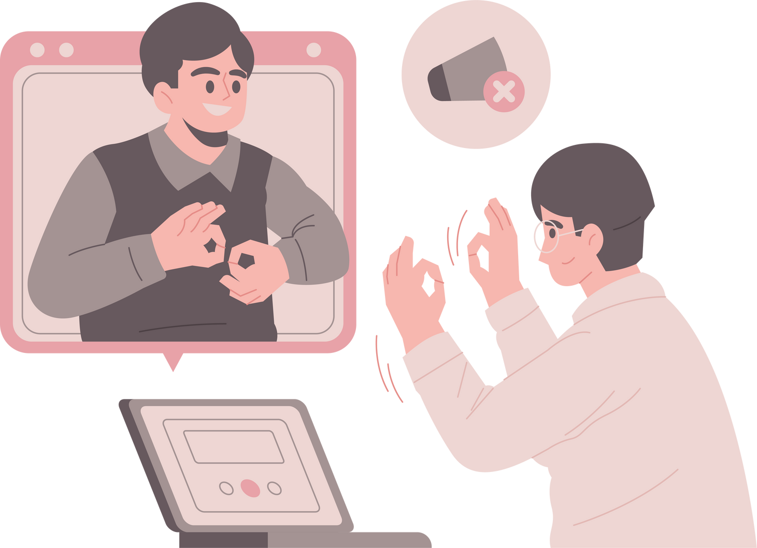
GestureSpeak
AI-Powered Real-Time Sign Language Translation
Project Team:
V. R Surya Ganesh - 21BRS1614
Sai Ruthwik - 21BCE5539
Manohar Reddy - 21BRS1177
Guide Details:
Name : Dr. Mohan R
School : SMEC
Cabin : AB1-406A,
3D printing Lab

Slide 2
Content
Introduction
Problem Statement
Literature Review
Methodology
VGG16 model
Dataset
Work to be Done
Project progress

Slide 3
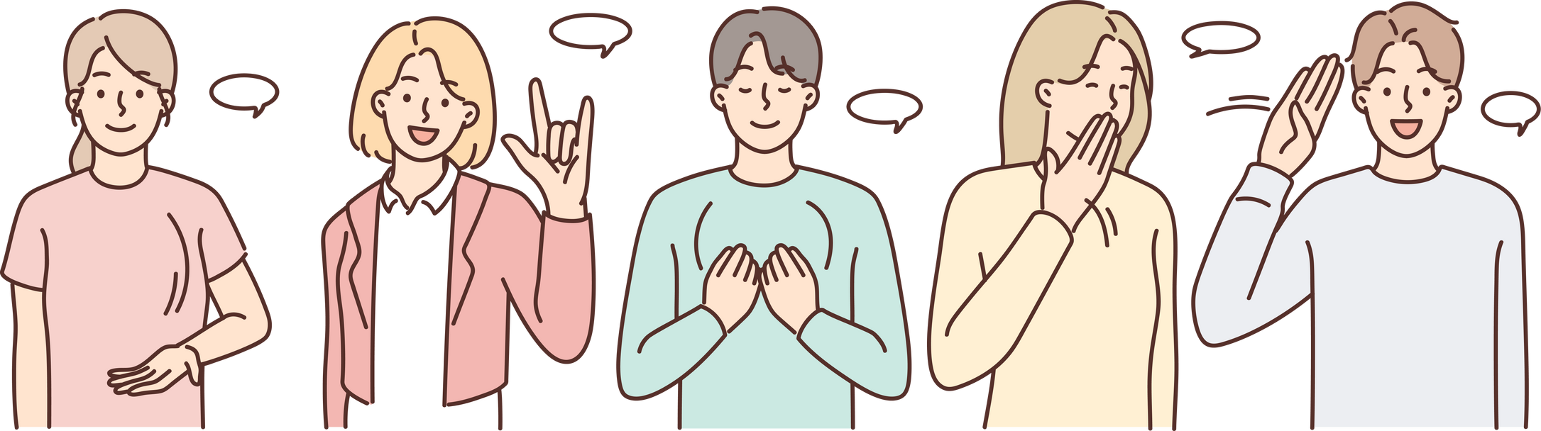
Introduction
The lack of a universal communication method between sign language users and non-signers creates significant barriers in both social and professional environments.
Current assistive technologies are either cumbersome or lack real-time capabilities, leaving a gap in effective communication solutions. Our project addresses this by integrating advanced machine learning models with real-time video processing, making seamless interaction possible across diverse settings.

Slide 4
Problem Statement
The aim to develop a highly accurate and real-time sign language recognition system to bridge the communication gap between sign language users and the broader community.
By utilizing CNNs trained on extensive American Sign Language (ASL) datasets, our system will classify and translate gestures into text with good precision.
The system is designed for scalability, allowing future extensions to include dual-hand gestures, facial expressions, and more complex sign languages, ensuring that the solution remains robust in diverse real-world scenarios.

Slide 5
Literature Review
Paper | Observation
Parallel hidden markov models for american sign language recognition. | This reseach aims to propose a novel approach using Parallel HMMs (PaHMMs) as a solution to this scalability problem. PaHMMs model parallel processes independently, which means they can be trained without considering all possible combinations of phonemes. This makes them more scalable for large vocabularies.
American sign language recognition using deep learning and computer vision | This project proposes a hybrid deep learning model for real-time sign language recognition. They combine LSTM for continuous signs and YOLOv6 for static signs. The model achieves high accuracy and is suitable for both sign language users and learners

Slide 6
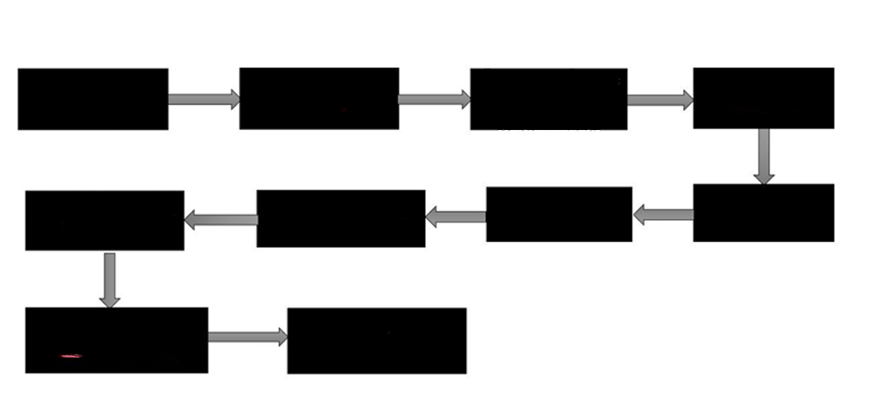
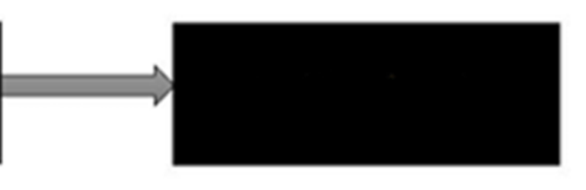

Methodology
Input
(Own Dataset)
Pre-process frames
(Resizing,
Normalization)
Mediapipe Extract Hand
Features
Gathering the data for training the model
Data processing for the training the model
OpenCV
Selecting model using VGG16, LSTM, MobilenetV2
Front-end
Testing the model in local machine
Impletmenting the best –fit model
(HTML, CSS, JS)
Backend WebSocket programming for 2-way communicaation
Deploying the
Application on cloud
Integrating backend
Flask with frontend

Slide 7
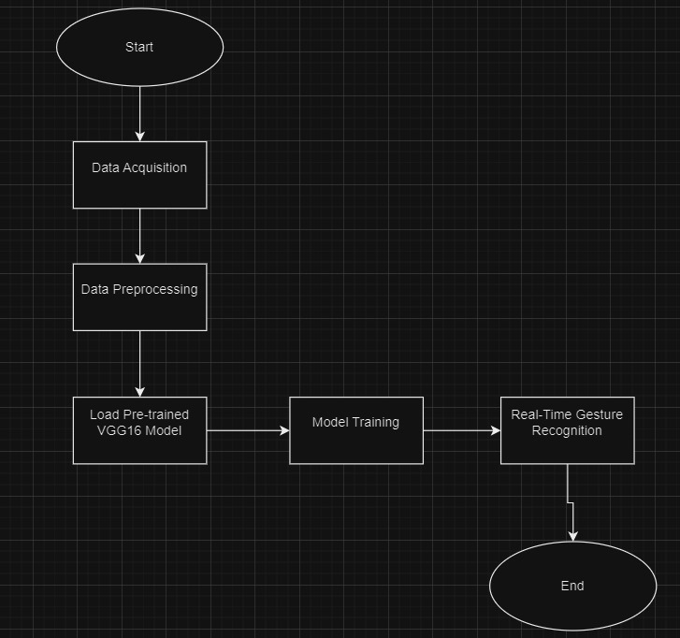
VGG16 Model

Slide 8
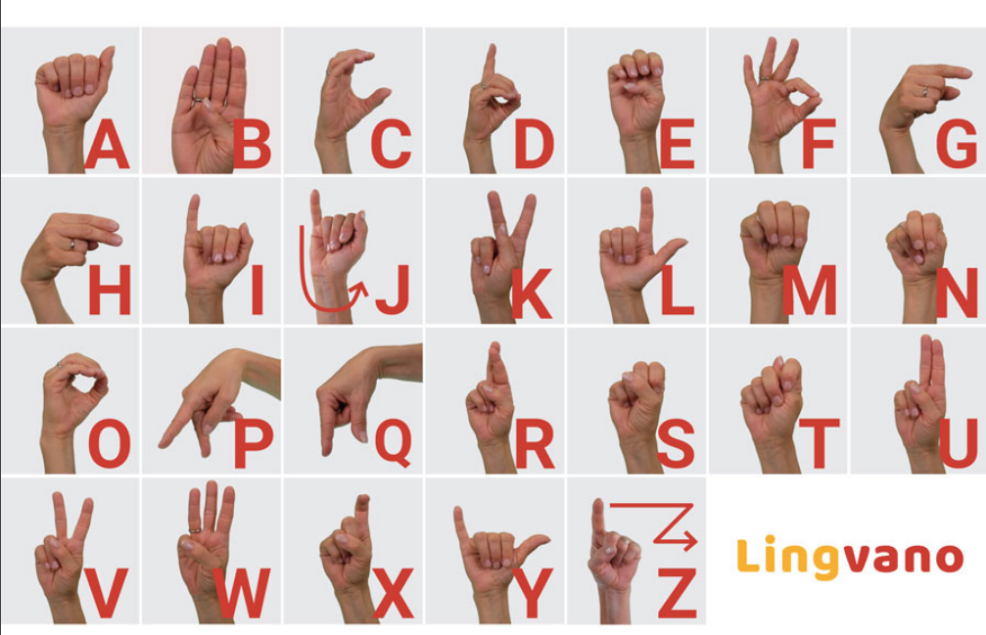
Signs for alphabets

Slide 9
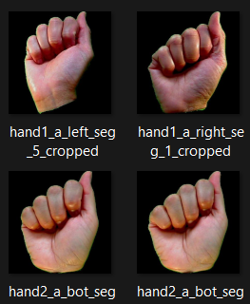
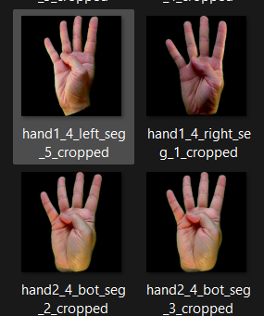
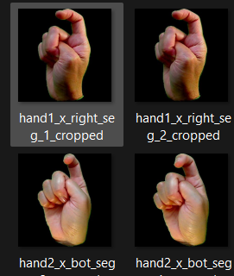
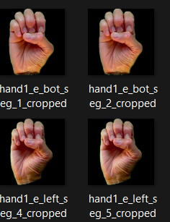
Data Set
Ee
Aa
5
Xx

Slide 10
Work To be done
Finalizing the machine learning best fit model
Implementing Websocket programing
Designing better user interface
Integrating user interface with backend
Deploying to cloud

Slide 11
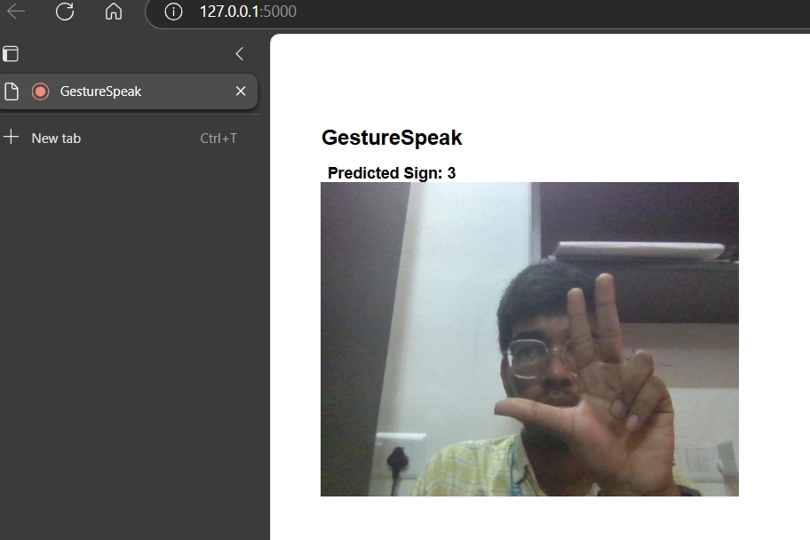
Project progress
After integrating VGG16 model with frontend using flask.
The following result in the
local host: 5000

Slide 12
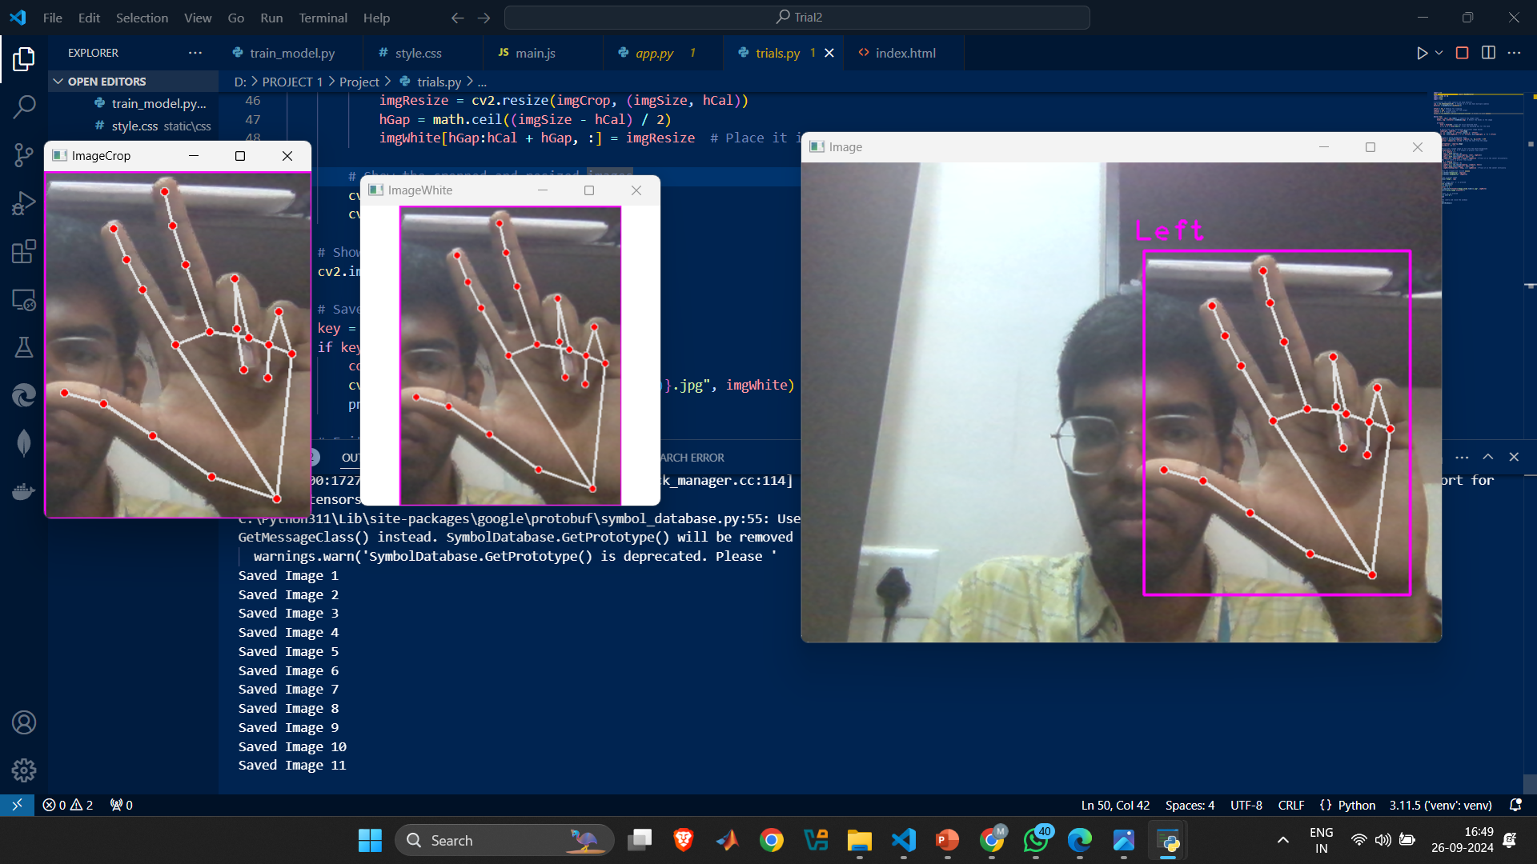
Project progress
Collecting the data for the training the model

Slide 13
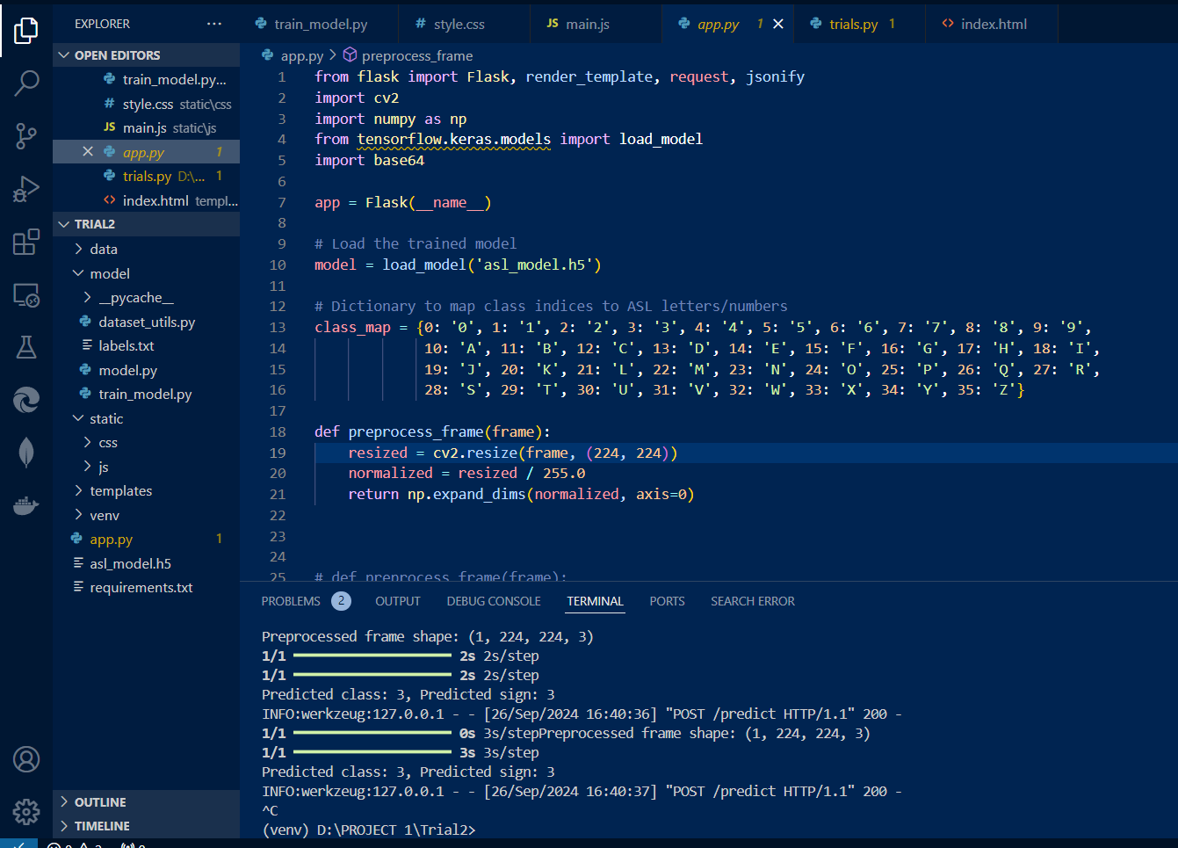
Project progress

Slide 14
Guide Details:
Name : Dr. Mohan R
School : SMEC
Cabin : AB1-406A,
3D printing Lab
Thank you Sir
Project Team:
V. R Surya Ganesh - 21BRS1614
Sai Ruthwik Reddy - 21BCE5539
V Manohar Reddy - 21BRS1177

